Slide 1

Discrete Time Dynamical Systems
MTH 564 – Mathematical Modeling

Slide 2
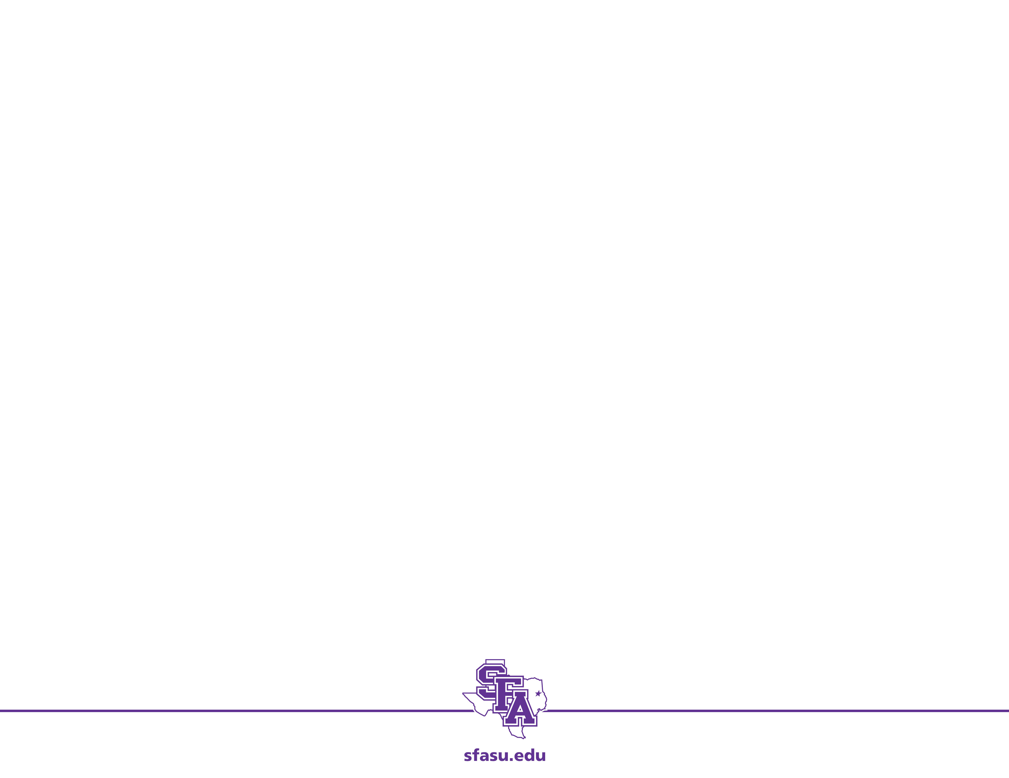
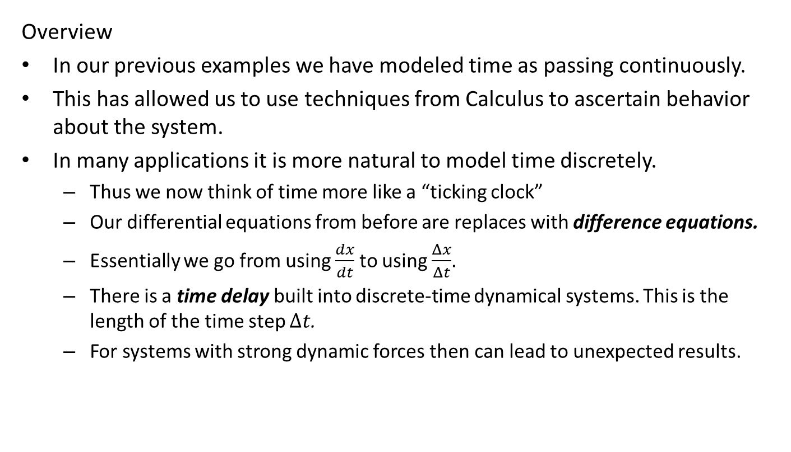
Discrete Time Dynamical Systems
Overview
In our previous examples we have modeled time as passing continuously.
This has allowed us to use techniques from Calculus to ascertain behavior about the system.
In many applications it is more natural to model time discretely.
Thus we now think of time more like a “ticking clock”
Our differential equations from before are replaces with difference equations.
Essentially we go from using $\frac{dx}{dt}$ to using $\frac{Δx}{Δt}$.
There is a time delay built into discrete-time dynamical systems. This is the length of the time step $Δt$.
For systems with strong dynamic forces then can lead to unexpected results.

Slide 3
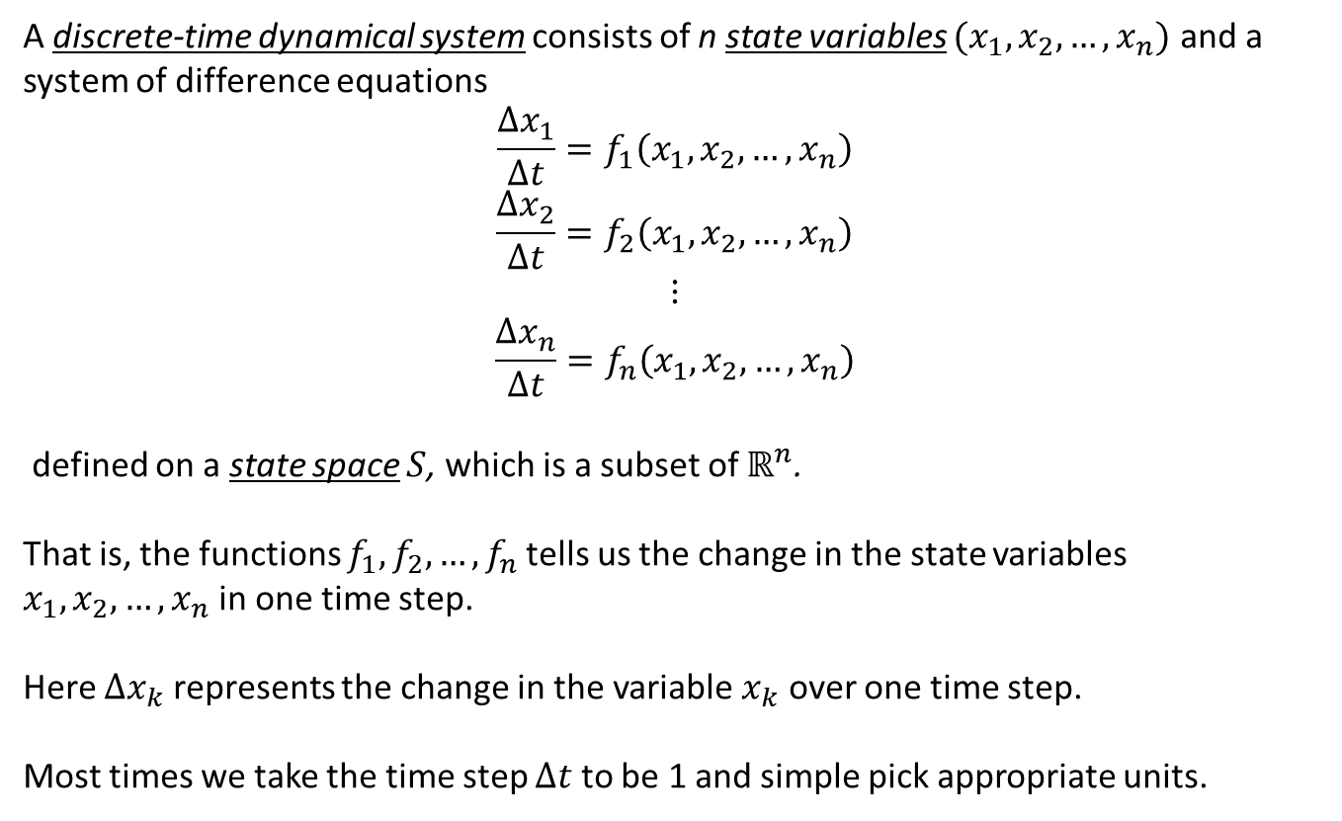
Discrete Dynamic Systems: Terminology
A discrete-time dynamical system consists of n state variables $(x_{1},x_{2},…,x_{n})$ and a system of difference equations
$$\frac{Δx_{1}}{Δt}=f_{1}\left(x_{1},x_{2},…,x_{n}\right)$$
$$\frac{Δx_{2}}{Δt}=f_{2}\left(x_{1},x_{2},…,x_{n}\right)$$
$$⋮$$
$$\frac{Δx_{n}}{Δt}=f_{n}\left(x_{1},x_{2},…,x_{n}\right)$$
defined on a state space $S$, which is a subset of $ℝ^{n}$.
That is, the functions $f_{1}, f_{2},…,f_{n}$tells us the change in the state variables $x_{1},x_{2},…,x_{n}$in one time step.
Here $Δx_{k}$ represents the change in the variable $x_{k}$ over one time step.
Most times we take the time step $Δt$ to be 1 and simple pick appropriate units.

Slide 4
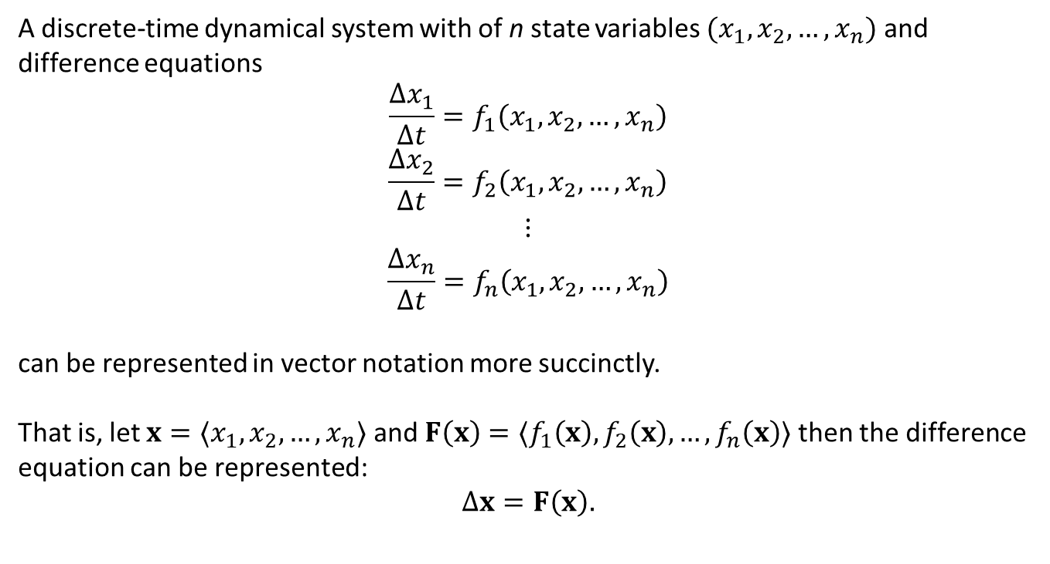
Discrete Dynamic Systems: Terminology
A discrete-time dynamical system with of n state variables $(x_{1},x_{2},…,x_{n})$ and difference equations
$$\frac{Δx_{1}}{Δt}=f_{1}\left(x_{1},x_{2},…,x_{n}\right)$$
$$\frac{Δx_{2}}{Δt}=f_{2}\left(x_{1},x_{2},…,x_{n}\right)$$
$$⋮$$
$$\frac{Δx_{n}}{Δt}=f_{n}\left(x_{1},x_{2},…,x_{n}\right)$$
can be represented in vector notation more succinctly.
That is, let ${x=〈x}_{1},x_{2},…,x_{n}〉$ and $F\left(x\right)=〈f_{1}\left(x\right), f_{2}\left(x\right),…,f_{n}\left(x\right)〉$ then the difference equation can be represented:
$$Δx=F\left(x\right).$$

Slide 5
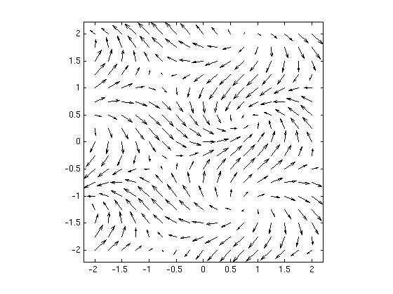
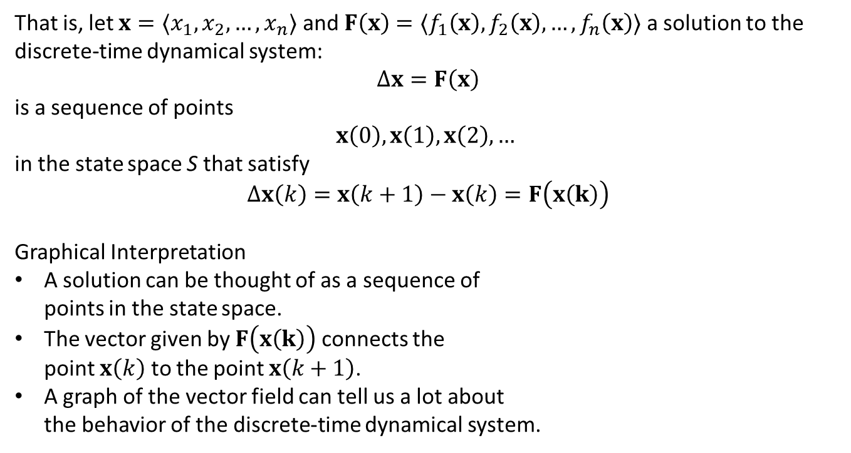



Discrete Dynamic Systems: Terminology
That is, let ${x=〈x}_{1},x_{2},…,x_{n}〉$ and $F\left(x\right)=〈f_{1}\left(x\right), f_{2}\left(x\right),…,f_{n}\left(x\right)〉$ a solution to the discrete-time dynamical system:
$$Δx=F\left(x\right)$$
is a sequence of points
$$x\left(0\right), x\left(1\right),x\left(2\right),…$$
in the state space S that satisfy
$$Δx\left(k\right)=x\left(k+1\right)−x\left(k\right)=F\left(x\left(k\right)\right)$$
Graphical Interpretation
A solution can be thought of as a sequence of points in the state space.
The vector given by $F\left(x\left(k\right)\right)$ connects the point $x\left(k\right)$ to the point $x\left(k+1\right)$.
A graph of the vector field can tell us a lot about the behavior of the discrete-time dynamical system.
$$x\left(k\right)$$
$$F\left(x\left(k\right)\right)$$
$$x\left(k+1\right)$$

Slide 6
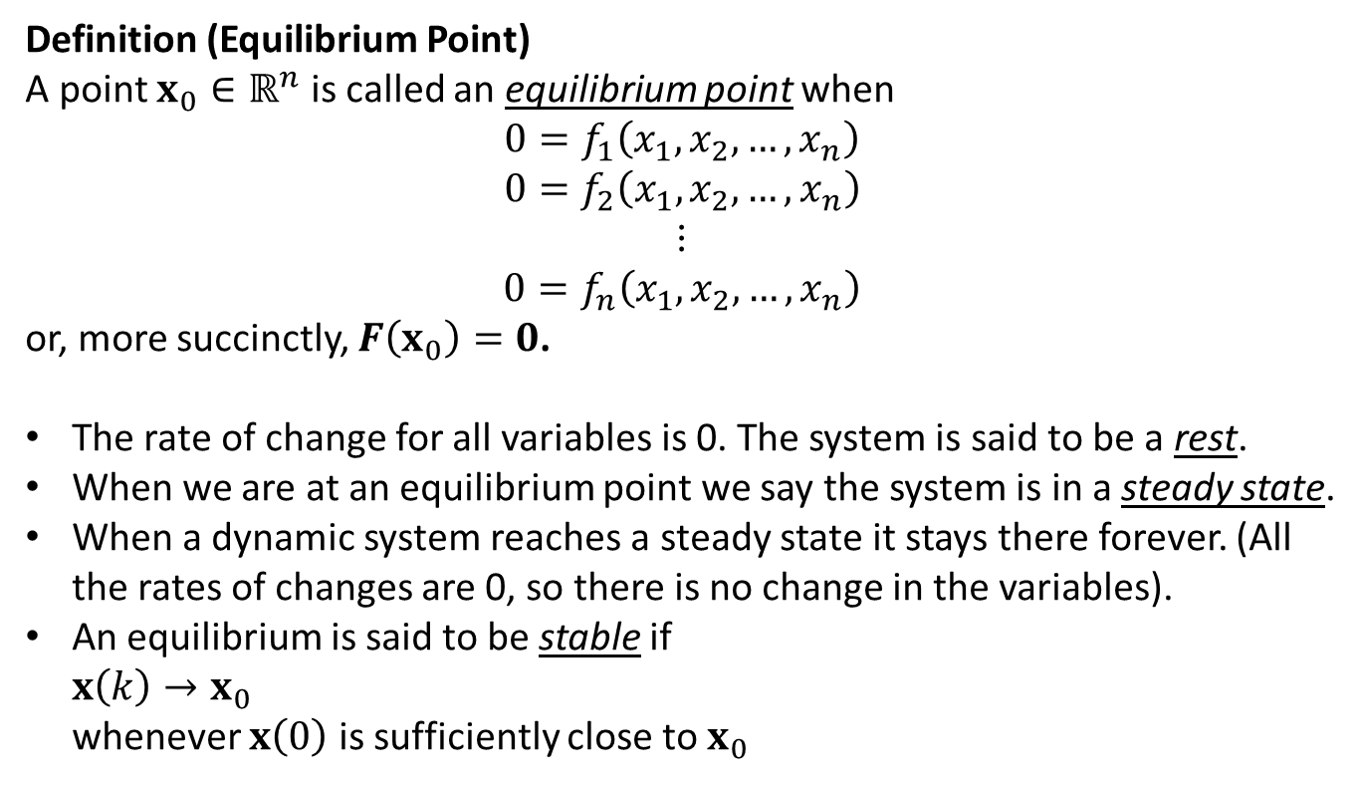
Discrete Dynamic Systems: Terminology
Definition (Equilibrium Point)
A point ${x_{0}∈ℝ}^{n}$ is called an equilibrium point when
$$0=f_{1}\left(x_{1},x_{2},…,x_{n}\right)$$
$$0=f_{2}\left(x_{1},x_{2},…,x_{n}\right)$$
$$⋮$$
$$0=f_{n}\left(x_{1},x_{2},…,x_{n}\right)$$
or, more succinctly, $F\left(x_{0}\right)=0$.
The rate of change for all variables is 0. The system is said to be a rest.
When we are at an equilibrium point we say the system is in a steady state.
When a dynamic system reaches a steady state it stays there forever. (All the rates of changes are 0, so there is no change in the variables).
An equilibrium is said to be stable if $x\left(k\right)→x_{0}$ whenever $x\left(0\right)$ is sufficiently close to $x_{0}$

Slide 7
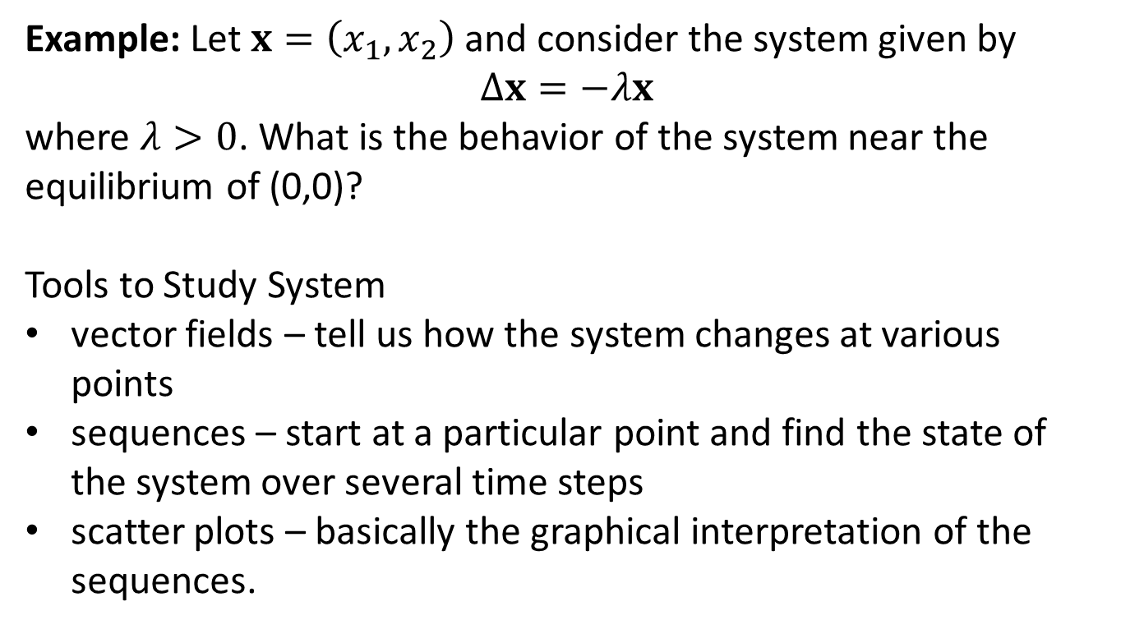
Example: Simple
Example: Let $x=\left(x_{1},x_{2}\right)$and consider the system given by
$$Δx=−λx$$
where $λ>0$. What is the behavior of the system near the equilibrium of (0,0)?
Tools to Study System
vector fields – tell us how the system changes at various points
sequences – start at a particular point and find the state of the system over several time steps
scatter plots – basically the graphical interpretation of the sequences.

Slide 8
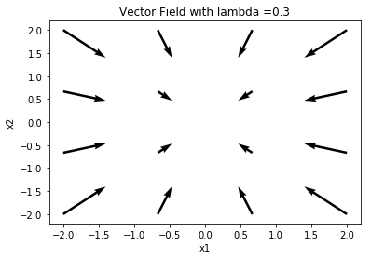
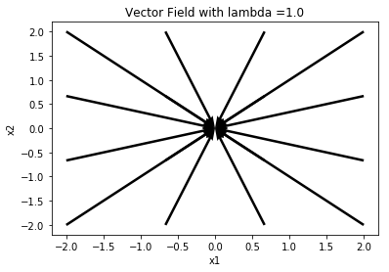
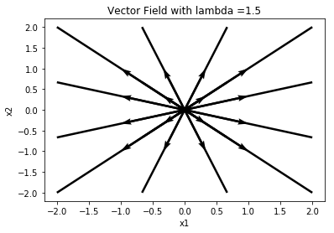
Example: Vector Fields
Example: Vector fields for$Δx=−λx$ using lambda value 0.3, 1.0, 1.5
0.3 – move gradually to origin (equilibrium)
1.0 – move to origin in one step
1.5 – move past origin each step
example.py
Notes:
0.3 – move to the origin
1.0 – move to the origin in one step
1.5 – move past the origin each

Slide 9
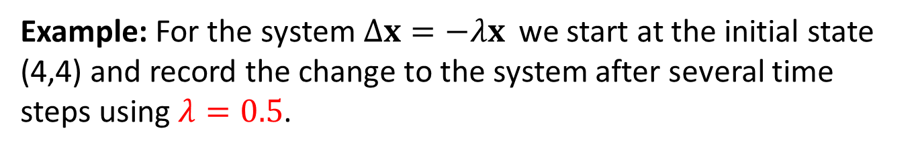
Example: Sequences
Example: For the system$Δx=−λx$ we start at the initial state (4,4) and record the change to the system after several time steps using $λ=0.5$.
Time Step | State
0 | (4,4)
1 | (2, 2)
2 | (1, 1)
3 | (0.5, 0.5)
4 | (0.25, 0.25)
5 | (0.125, 0.125)
Interpretation: At every time step we move half the distance towards the origin.
The origin is a stable equilibrium for this system.

Slide 10

Example: Sequences
Example: For the system$Δx=−λx$ we start at the initial state (4,4) and record the change to the system after several time steps using $λ=1.5$.
Time Step | State
0 | (4,4)
1 | (-2, -2)
2 | (1, 1)
3 | (-0.5, -0.5)
4 | (0.25, 0.25)
5 | (-0.125, -0.125)
Interpretation: At every time step we move half the distance PAST the origin.
The origin is a stable equilibrium for this system.

Slide 11
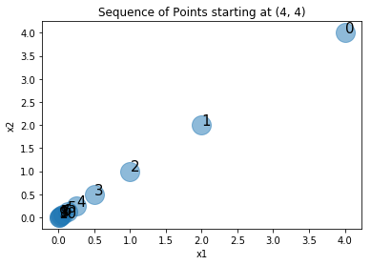
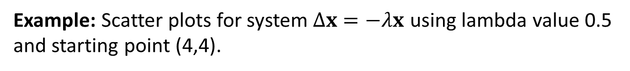
Example: Scatter Plot
Example: Scatter plots for system$Δx=−λx$ using lambda value 0.5 and starting point (4,4).
Behavior: Gradually move towards stable equilibrium at the origin (0,0).

Slide 12
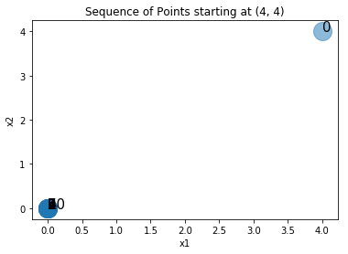
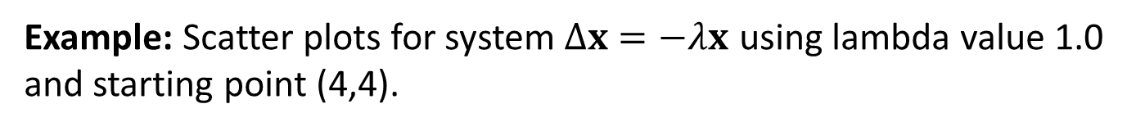
Example: Scatter Plot
Example: Scatter plots for system$Δx=−λx$ using lambda value 1.0 and starting point (4,4).
Behavior: Move to stable equilibrium at the origin (0,0) in 1 time step

Slide 13
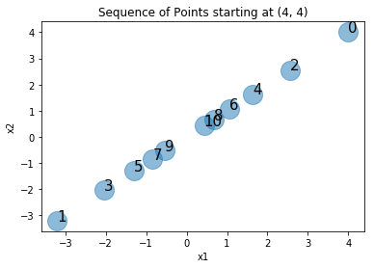
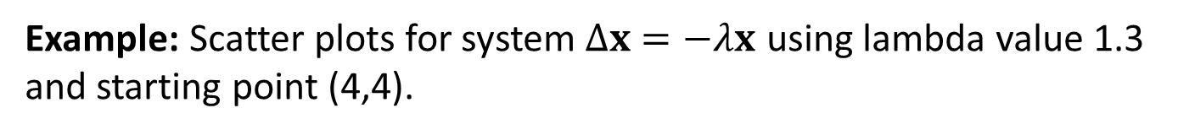
Example: Scatter Plot
Example: Scatter plots for system$Δx=−λx$ using lambda value 1.3 and starting point (4,4).
Behavior: Move past the origin on each step but also gradually toward stable equilibrium at the origin (0,0).

Slide 14
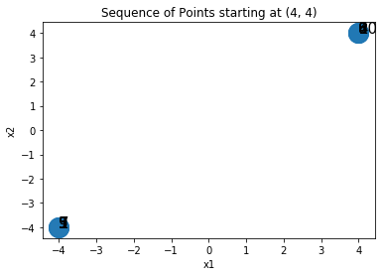
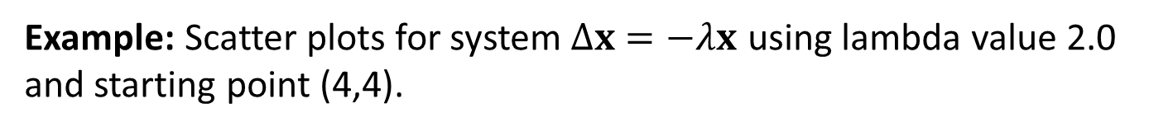
Example: Scatter Plot
Example: Scatter plots for system$Δx=−λx$ using lambda value 2.0 and starting point (4,4).
Behavior: Move back and forth between (4,4) and (-4,-4) The origin (0,0) is NOT a stable equilibrium.

Slide 15
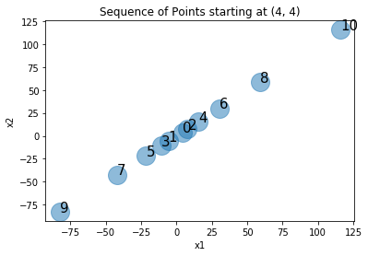
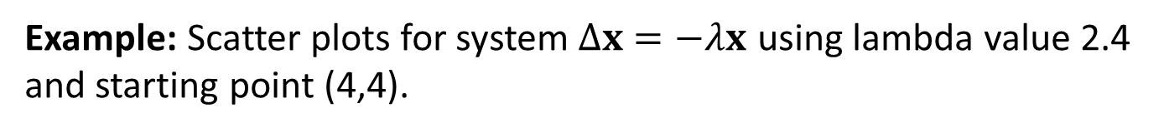
Example: Scatter Plot
Example: Scatter plots for system$Δx=−λx$ using lambda value 2.4 and starting point (4,4).
Behavior: At each step we move past the origin and further away from it. The origin (0,0) is NOT a stable equilibrium.

